Slide 1
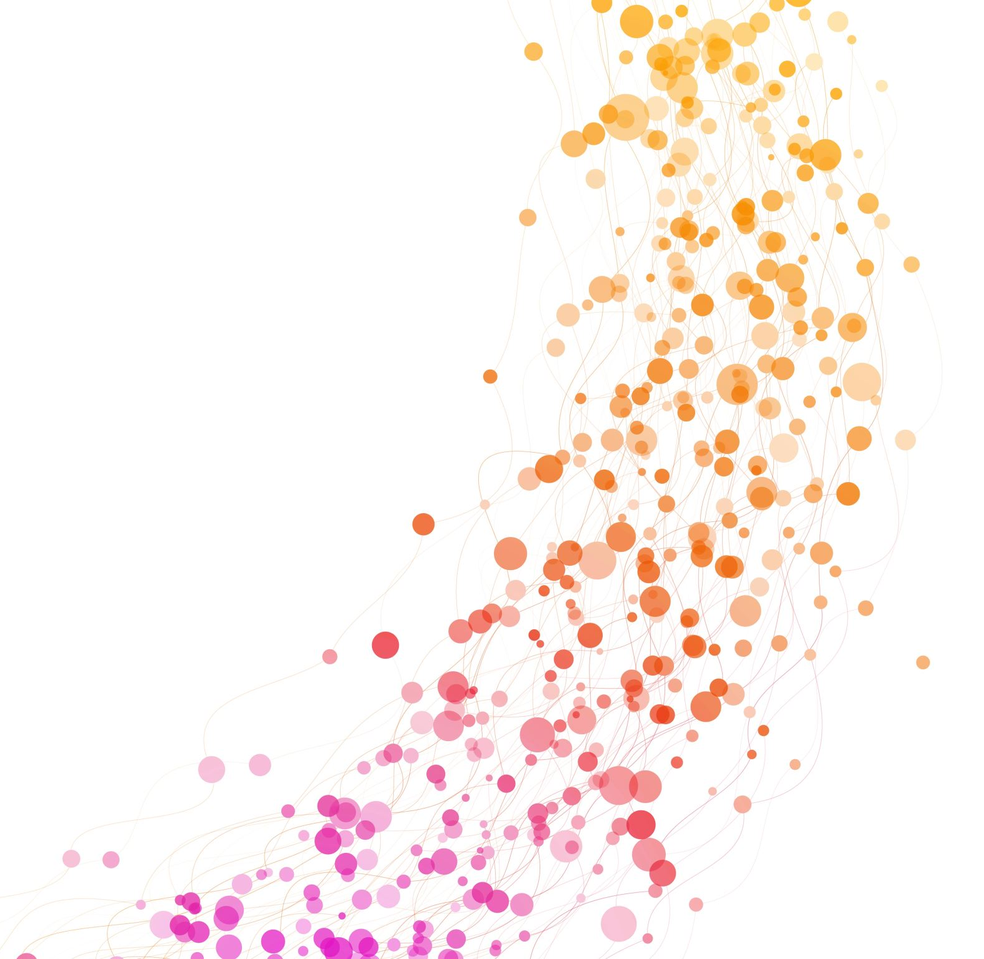
Lightweight Reinforcement Learning for Personalized Adaptive Learning Systems
Advance AI – Assignment Presentation
Humaima Anwar
FA25-RAI-011

Slide 2
Adaptive Learning Systems
Research Domain: AI (Reinforcement Learning) + Education (Adaptive Learning Systems)
Adaptive Learning Systems personalize content, difficulty, and sequencing in real-time based on student performance.
Goal: Enhance learning outcomes through tailored educational experiences.
Traditional education often uses a “one-size-fits-all” approach, which fails to address individual learner differences.

Slide 3
Related Work: Key Studies in RL for Education
Amin et al. (2023): Used Q-learning for learning path personalization in MOOCs.
Sharif & Uckelmann (2024): Proposed KNIGHT framework with Deep RL and multi-modal analytics.
Fahid et al. (2024): Explored RL in narrative-centered learning environments.
Common Limitation: Complexity limits interpretability and scalability.

Slide 4
Gap Between Research and Practical Deployment
Existing Reinforcement Learning (RL) solutions are often complex, resource-heavy, and hard to interpret (e.g., Deep Q-Networks, multi-modal data).
There is a lack of lightweight, interpretable RL models that can be easily deployed in real educational settings.
Research Question: Can a simple RL model outperform traditional rule-based methods in personalizing question sequences?

Slide 5
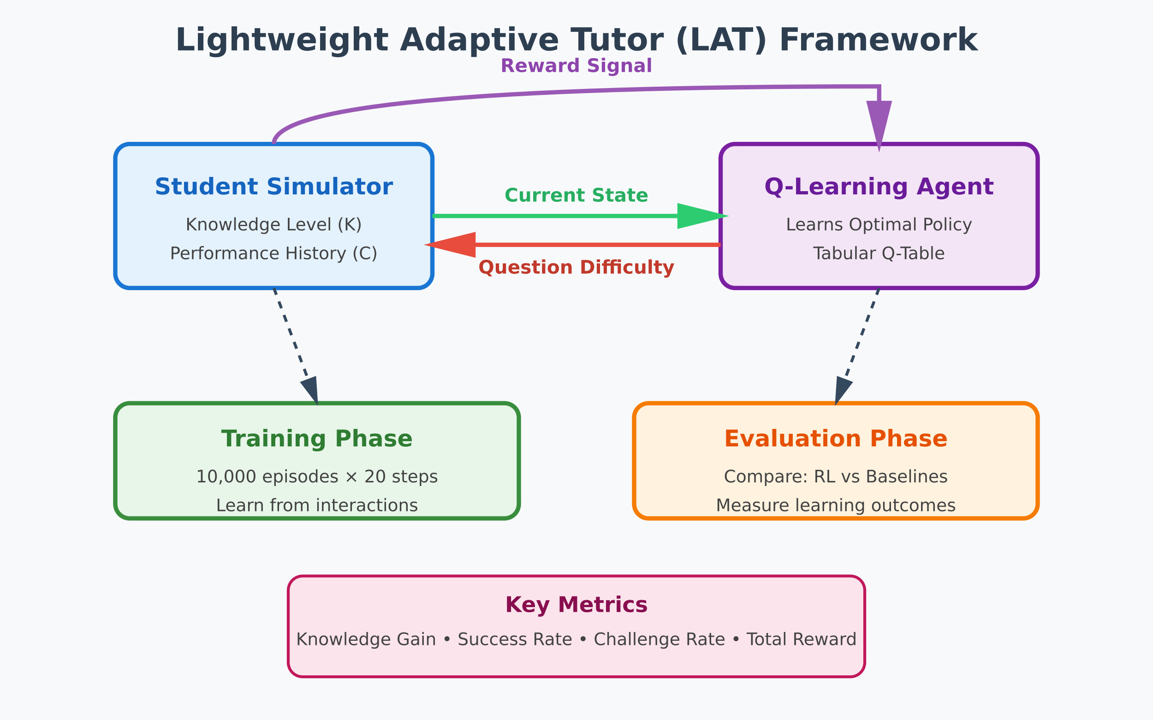
Proposed Solution: Lightweight Adaptive Tutor (LAT) Framework
Uses tabular Q-learning – simple, interpretable, and convergent.
State Space: 70 discrete states (Knowledge × Consecutive Performance).
Action Space: Easy, Medium, Hard questions.
Reward Function: Encourages correct answers on harder material. Incorrect answers give a lower or negative reward.
Novelty: Lightweight, model-free, directly comparable to rule-based baselines (Fixed Schedule, Performance-Threshold).

Slide 6
Data & Simulation Environment: Synthetic Data via Student Knowledge Simulator
Real student data is scarce and noisy → uses a simulated student model.
State Representation: Knowledge level (0–1) + consecutive correct/incorrect count.
Interaction Tuple: (State, Action, Reward, Next State).
Training: 200,000 interactions from 10,000 episodes.
Testing: 20,000 interactions from 1,000 independent episodes.

Slide 7
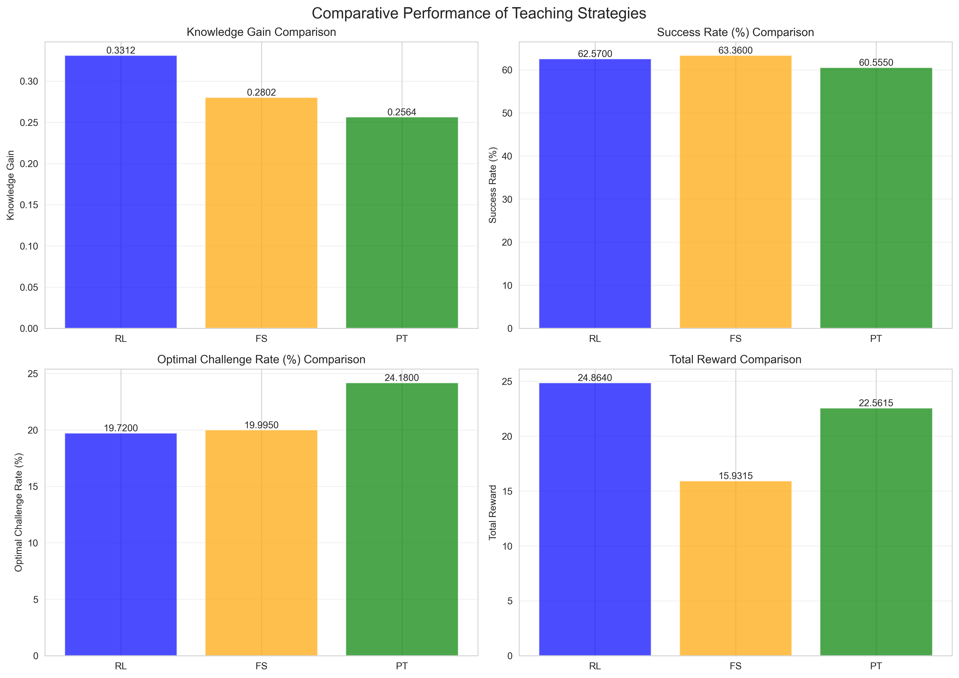
Results
RL Agent outperformed baselines in:
      Knowledge Gain (+4.76% over PT)
      Success Rate (+7.52% over PT)
      Total Reward (significant over FS)
Interpretable Policy: Easy questions for novices, medium for intermediates, hard after successes, easy after failures.

Slide 8

Conclusion
A simple Q-learning agent outperformed rule-based methods in a simulated tutoring system, achieving better knowledge gains and success rates. This confirms that lightweight, interpretable RL is practical for scalable adaptive learning.
Future Work
Test with real students
Add more student states (e.g., engagement)
Improve rewards for long-term learning
Scale to classrooms and other subjects

